Slide 1
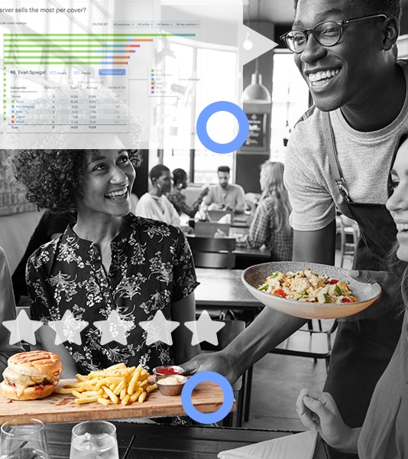
Restaurant PUBLIC INFORMATION and Business Performance Analysis
Introduction to Data Science Capstone Project WIP Report

Slide 2

TABLE OF CONTENT
DATA SCIENCE OVERVIEW
RESTAUNRANT PUBLIC INFORMATION
RESTAURANT BUSINESSS PERFORMANCE (WORK IN PROGRESS)
RELATED DATA
VISUALIZATION AND ANALYSIS (WORK IN PROGRESS)

Slide 3

DATA SCIENCE OVERVIEW
Definition; Methodology and Challenges

Slide 4
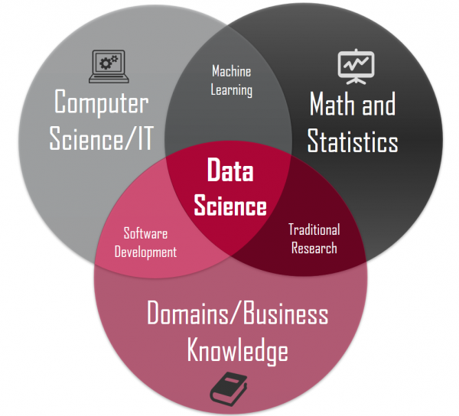
DEFINITION
Data science is an interdisciplinary field that uses scientific methods and algorithms to collect, extract and process knowledge from potentially noisy and unstructured data so as to understand, visualize and communicate with that information

Slide 5
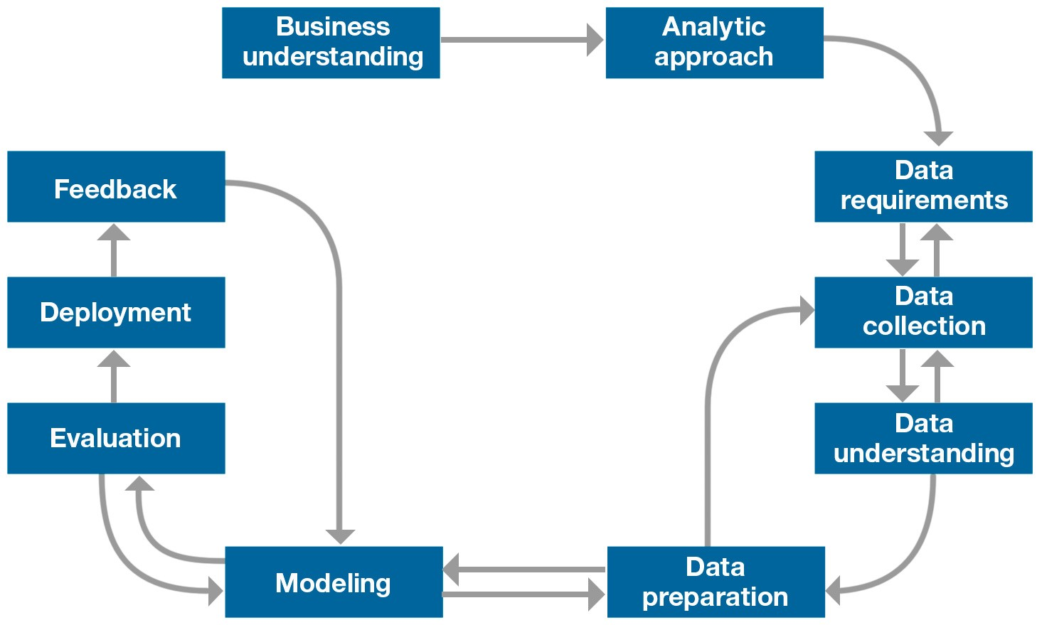
METHODOLOGY
Methodology in Data Science is a productive way to organize Data Science work to achieve more substantial result and avoid wasting valuable time

Slide 6
CHALLANGES
UNSTRUCTURED DATA
HIGH DIMENSIONLITY
VOLUME; VARIETY; VELOCITY; VERACITY
Data is too large and varied, coming too quickly and included many errors or uncertainty
Data contains text; links; images; emoji…
Data has many dimensions, like images.

Slide 7
RESTAUTANT DATA
For the Capstone project, we decided to analyze restaurant data because
Restaurant data is enormous
Restaurant public information, such as rating, distribution or pricing, is widely available and scrapable
Restaurant business information is valuable and lucrative
Related data can contain interesting patterns for discovery and analyzation
Final result may produce beneficial results for real-world implementation

Slide 8

RESTAURANT PUBLIC INFORMATION
Collecting restaurant public information

Slide 9
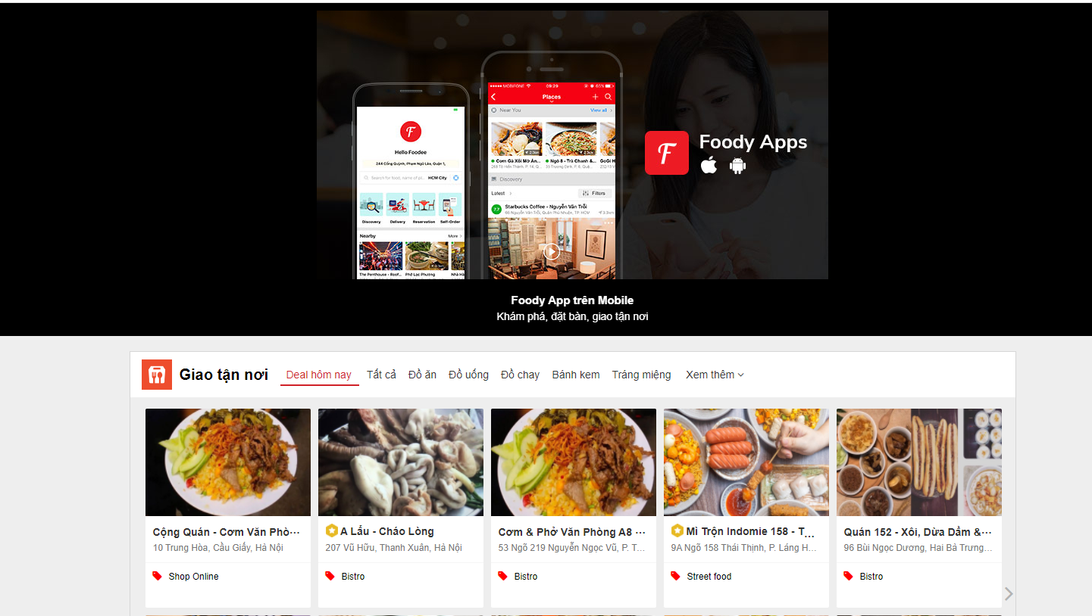
RESTAURANT PUBLIC INFORMATION
Restaurant information include pricing, location and rating
They are publicly available in websites like Foody, ShopeeFood or Pasgo

Slide 10
RESTAURANT PUBLIC INFORMATION
Data was scrapped with Js Scrappy
Data is organized in a .csv file, containing restaurant name, location, pricing, cuisine and rating
Missing data were either discarded or filled with mean values
Noisy and inconsistent data were also handled

Slide 11

RESTAURANT BUSINESS PERFORMANCE
Collecting restaurant business performance data

Slide 12
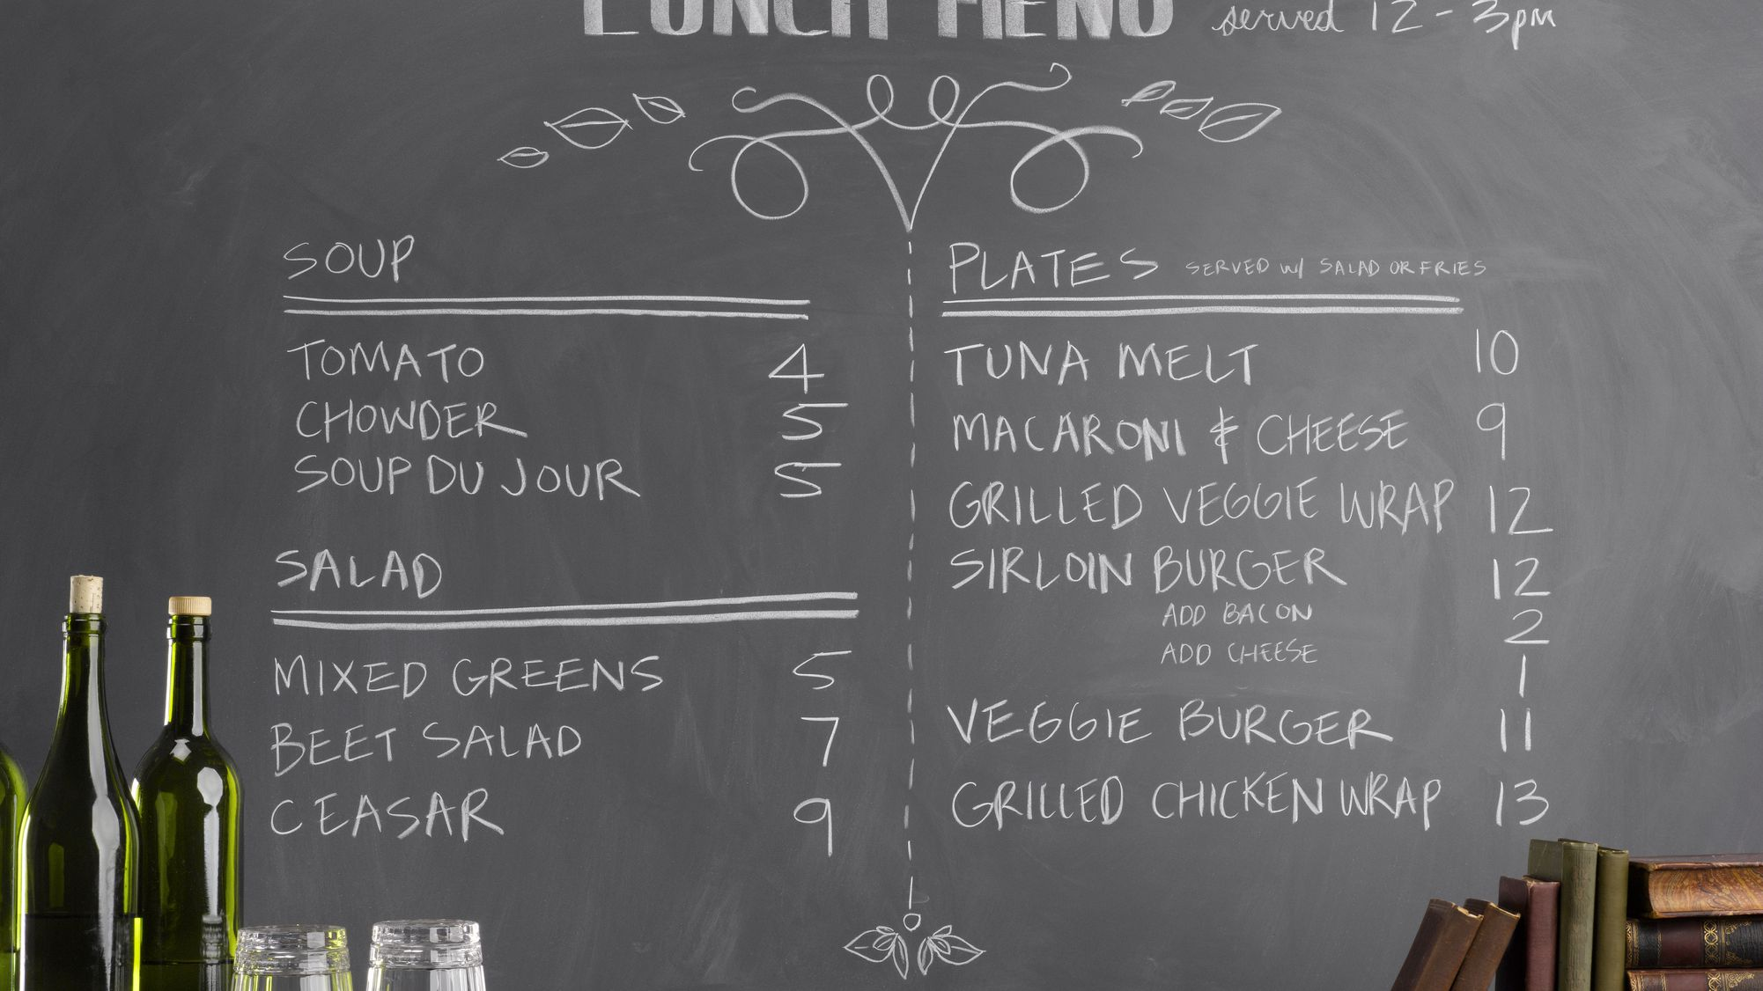
RESTAURANT BUSINESS PERFORMANCE
Restaurant business performance data is not publicly available, but members of team believes we can communicate with various restaurants and ask for such information. This is a work in progress, but we will see what we can do!

Slide 13

RELATED DATA
Related data, such as population, income or real estate, may provide additional information

Slide 14
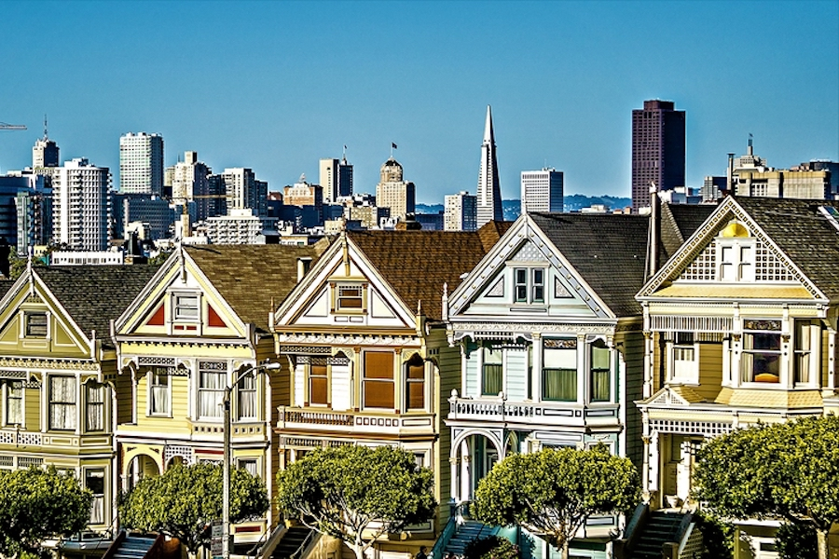
RELATED DATA
We also collect related information, such as population, income and real estate data, which are publicly available from various sources, to assist our comparison and analyzation.

Slide 15

VISUALIZATION AND ANALYSIS
Visualization and analysis of collected data

Slide 16
VISUALIZATION AND ANALYSIS
Restaurant public information and related data are openly available, so we will be analyzing and visualizing the correlations between: population versus restaurant distribution, rating versus location and cuisine versus pricing
Depend of the information we can collect, especially about restaurant business performance, we will include more analysis

Slide 17

Thank you
Thank you for your participation

